Slide 1
Microsoft SQL Server
Index Analysis and Performance Improvement
Heap - Clustered Index – Non Clustered Index

Slide 2
Links for this Session/Workshop
Scripts and Slide Decks https://github.com/db-berater/partitioning-for-beginners
ERP Demo Database (17.00 GB) https://db-berater.de/downloads/ERP_Demo_2012.bak
SQLQueryStress https://github.com/ErikEJ/SqlQueryStress
Windows Admin Center https://go.microsoft.com/fwlink/?linkid=2220149

Slide 3




Uwe Ricken db Berater GmbH
I am working with IT-systems since early 1990's and with the main focus on Microsoft SQL Server since version 6.0. I started with development of database applications in 1998 with a professional CRM-System based on Microsoft products (Microsoft Office and Microsoft SQL Server).
Since 2008 I'm focused exclusively on Microsoft SQL Server and working in 3rd level support teams for banks, insurances and global industries.
Since May 2013 I am a Microsoft Certified Master: SQL Server 2008 which was an amazing way into the depth of Microsoft SQL Server.
In July 2013 I have been awarded with the MVP Award for Microsoft SQL Server.
www: http://www.db-berater.de
email: uwe.ricken@db-berater.de
blog: http://www.sqlmaster.de
BlueSky: @sqlbambi

Slide 4
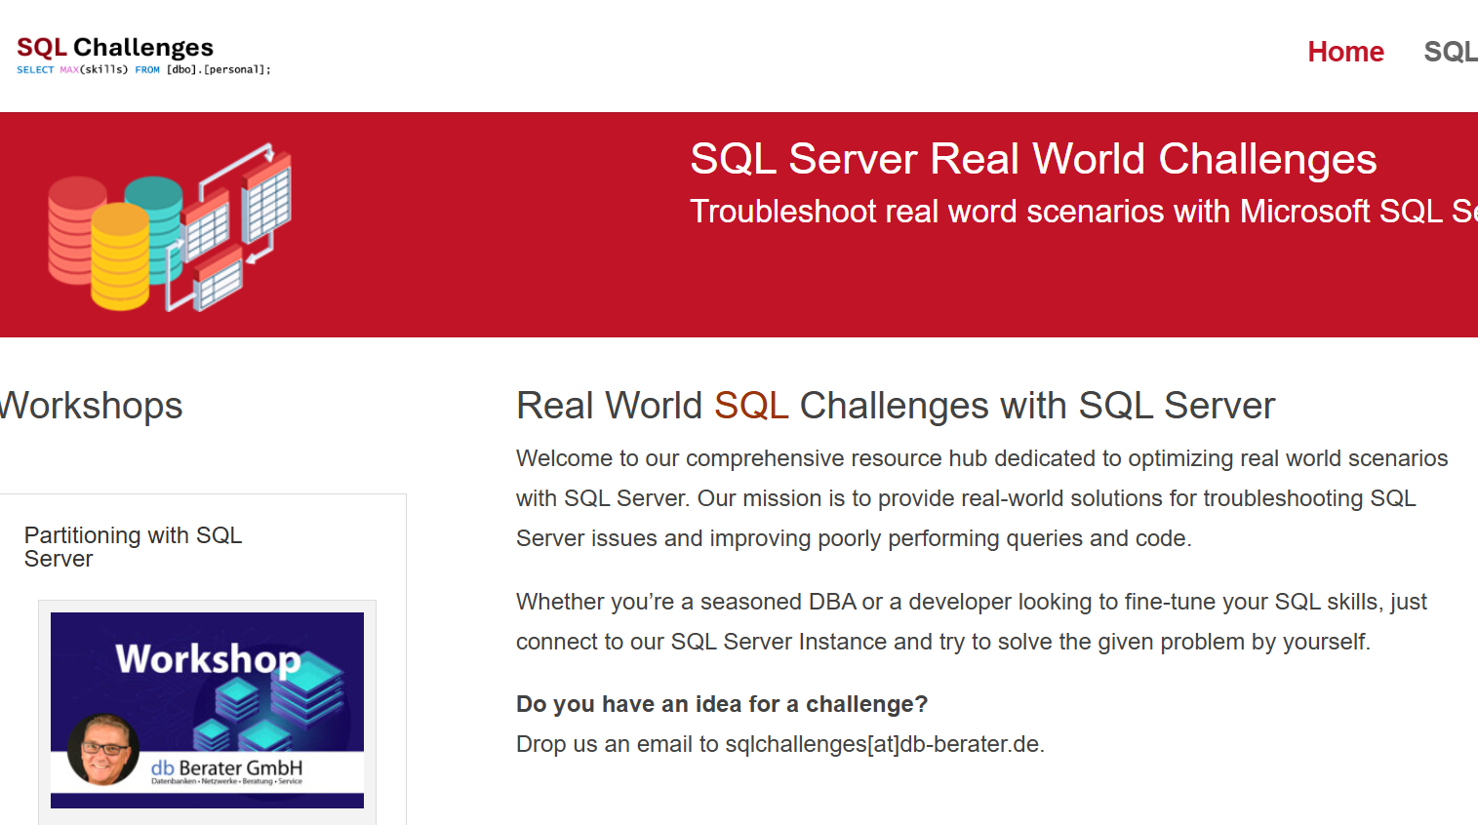
Challenge SQL Server real world scenarios
Get a challenge at least once a month
Connect to a provided SQL Server Instance
Load the challenge scenario
Try to solve it
Blog about your solution
Leave a link in the comments of the challenge to your blog post.
https://sqlchallenges.de

Slide 5
Agenda
Indexstrukturen
HEAP
Clustered Index
Non Clustered Index
Interpretation von Abfrageoperatoren
Table Scan / Clustered Index Scan
Index Seek
Allgemeine Probleme mit Indexen
Statistiken
Parameter Sniffing
Operator-Eliminierung durch CHECK-Einschränkung und Fremdschlüssel-Einschränkung
Reihenfolge der Attribute in kombiniertem Index

Slide 6
Indexstrukturen
HEAPS / CLUSTERED INDEXES / NONCLUSTERED INDEXES

Slide 7
Anatomie eines Heap?
IAM 110 123 150 …
Ein HEAP ist eine Tabelle ohne Ordnungskriterium.
Zwischen den einzelnen Datenseiten besteht KEINE direkte Verbindung
L 110
L 123
L 150
L 151
L 152

Slide 8
Anatomy of a Clustered Index
Clustered indexes sort and store the data rows in the table or view based on their key values.
These are the columns included in the index definition.
There can be only one clustered index per table, because the data rows themselves can be sorted in only one order.
The only time the data rows in a table are stored in sorted order is when the table contains a clustered index.
Root Node
Inter med. node
Inter med. node
Inter med. node
Leaf 110
(Data)
Leaf 111
(Data)
Leaf 112
(Data)
Leaf 113
(Data)
Leaf 114
(Data)
Leaf 115
(Data)

Slide 9
Anatomy of a Clustered Index
Root Node
Intermediate Node
Intermediate Node
Intermediate Node
Intermediate Node
Data
Data
Data
Data
Data
Data
Data
Data
Data

Slide 10
Anatomy of a Clustered Index
Level 2
(Id) NULL – 2500 2501 – 5000
5001 – 7500
Level 1
NULL - 2500
2501 – 5000
5001 – 7500
7501 – 10000
Level 0
1.234
2109
2487
2700
4999
5145
7345
7890
9999

Slide 11
Anatomy of a Clustered Index
Level 2
SELECT * FROM dbo.Customers
WHERE Id = 2109;
(Id) NULL – 2500 2501 – 5000
5001 – 7500
Level 1
NULL - 2500
2501 – 5000
5001 – 7500
7501 – 10000
2487
4999
4999
7345
1.234
2109
2700
5145
7345
9999
Level 0
5145
7890

Slide 12
Anatomy of a Clustered Index
Level 2
SELECT * FROM dbo.Customers
WHERE Id = 8091;
(Id) NULL – 2500 2501 – 5000
5001 – 7500
Level 1
NULL - 2500
2501 – 5000
5001 – 7500
7501 – 10000
2487
4999
7345
1.234
2109
2700
5145
7345
9999
Level 0
5145
7890

Slide 13
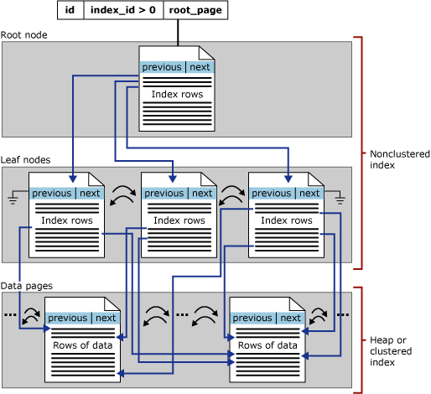
Anatomie eines “Non Clustered Index”
Nonclustered Indexe haben die gleiche B-tree Struktur wie Clustered Indexe mit drei signifikanten Unterschieden:
Der Index beinhaltet ausschließlich Daten, die durch die Indexdefinition in den Index aufgenommen werden.
Jeder Nonclustered Index hat zusätzliche Informationen / Referenzen zur Tabelle im Index.
Fehlende Informationen müssen IMMER aus dem Clustered Index / Heap ermittelt werden!
http://technet.microsoft.com/en-us/library/ms177484.aspx

Slide 14
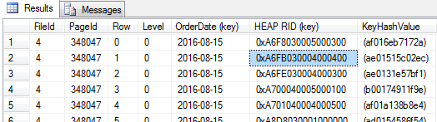
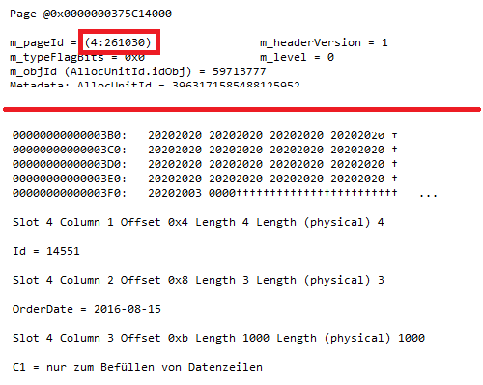
RID-Lookup in Heap
RID: 0xA6FB030004000400
PAGE: 0xA6FB0300
File: 0x0400
Slot: 0x0400
RID: 0xA6FB030004000400
PAGE: 261030
File: 4
Slot: 4

Slide 15
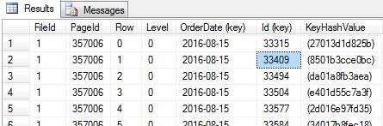
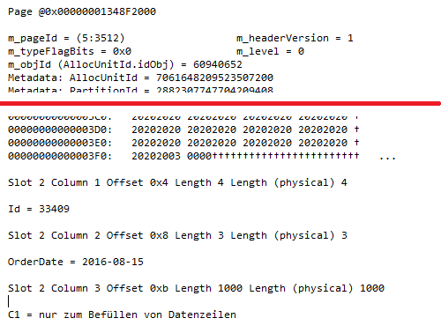
Key-Lookup in Clustered Index
Root
127
352
353
353
3510
3511
3512

Slide 16
Demo
Thema: Aufbau eines Nonclustered Index und Besonderheiten bei der Abfrage von Nonclustered Indexen
Skript: 0022 - demonstration of NONCLUSTERED INDEX.sql

